Slide 1







首届中国eBPF研讨会
www.ebpftravel.com
eBPF在Android平台的实践
燕 青 洲
Nov. 2022

Slide 2



目 录
首届中国eBPF研讨会
adeb (android debian)
eBPF Introduction
Android eBPF Implementation
BTF (BPF Type Format)
eBPF changes for Android
Analyzing issues with eBPF

Slide 3

首届中国eBPF研讨会
01
adeb (android debian)

Slide 4





01
adeb (android debian)
首届中国eBPF研讨会
adeb又名androdeb，旨在Android手机上，搭建了一个基于adb shell命令行的debian shell环境，使得手机可以同时运行Android系统和Debian系统命令。
因此可直接运行主流Linux下的命令行工具，方便我们对Android系统进行tracing、debugging、profiling ...
官方网址:
https://github.com/joelagnel/adeb
AOSP集成版本:
https://android.googlesource.com/platform/external/adeb

Slide 5
亮点
首届中国eBPF研讨会
1. 可以使用Linux(Debian)下各种强大的开发工具(gcc/clang/perl/python)直接在线编辑、编译、调试、跟踪；
2. 无需搭建交叉编译，本地直接集成Debian(arm64)环境，可通过apt-get安装各种缺少的开发包，编译出arm64直接可用的本地程序；
3. 借助Debian环境，可以使用常规的perf/bcc-tools/bpftrace来跟踪调试kernel，无须移植、裁剪、交叉编译；

Slide 6
运行环境要求
首届中国eBPF研讨会
PC主机建议 Ubuntu 或 Windows WSL (WSL建议使用Ubuntu20.04发行版, version 1即可)
平台版本 >= Android N(arm64)
支持 "adb root“
userdebug版本 (强烈建议，debugfs依赖)
/data分区至少拥有 2GB 剩余空间
4G可用内存 (建议)
► adb for linux : https://dl.google.com/android/repository/platform-tools-latest-linux.zip
注: Win环境也可以用 busybox.exe shell 来模拟，需要对 adeb 做部分修改适配

Slide 7
adeb配置及运行
首届中国eBPF研讨会
[ Quick Start ]
git clone https://github.com/joelagnel/adeb.git
cd adeb
sudo ln -s $(pwd)/adeb /usr/bin/adeb
[ 默认安装方式 ]
# 安装adeb环境到已连接adb的Android手机 (adeb prepare --archive /path/to/mydeb-fs.tgz)
adeb prepare
# 上述操作会下载和安装基础debian image，如果要装完整版本请使用
adeb prepare --full
# 安装完成后，运行开启adeb shell环境
adeb shell
# 卸载
adeb remove
Notes:
adeb shell
# apt update
# apt upgrade

Slide 8
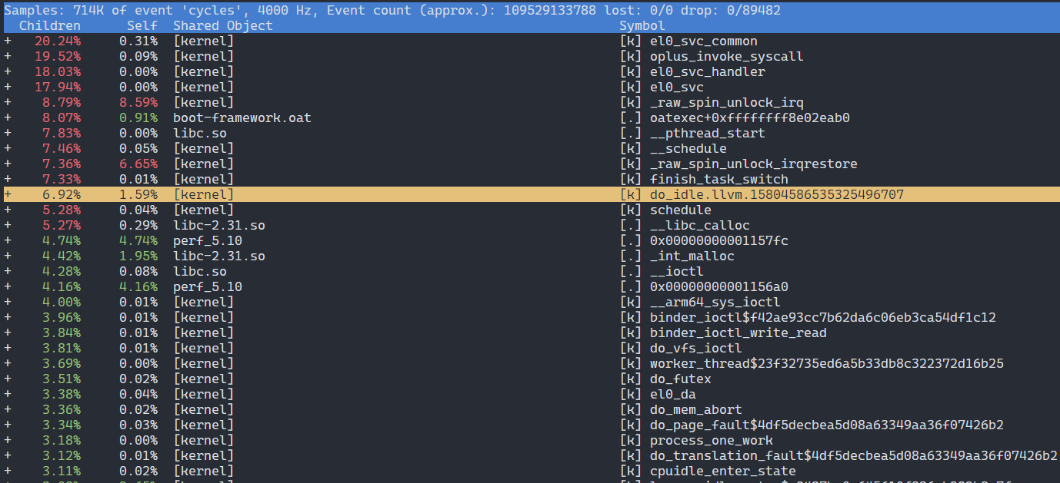
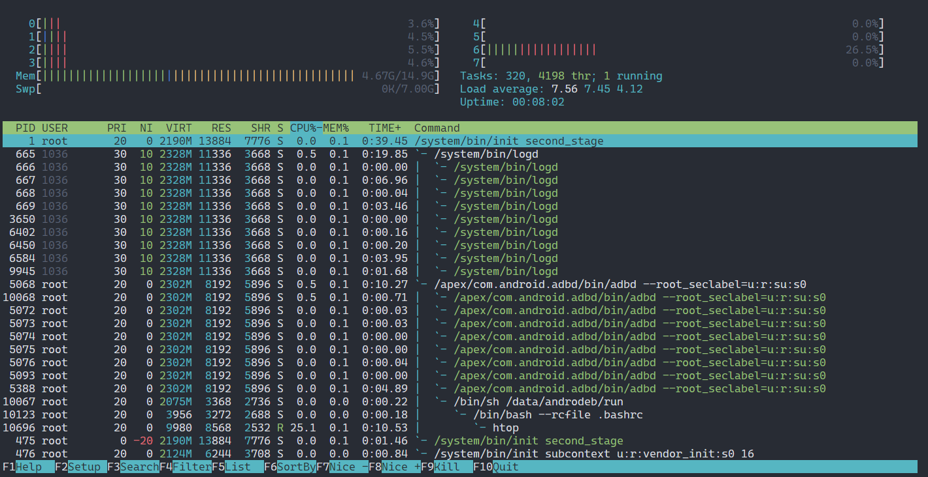
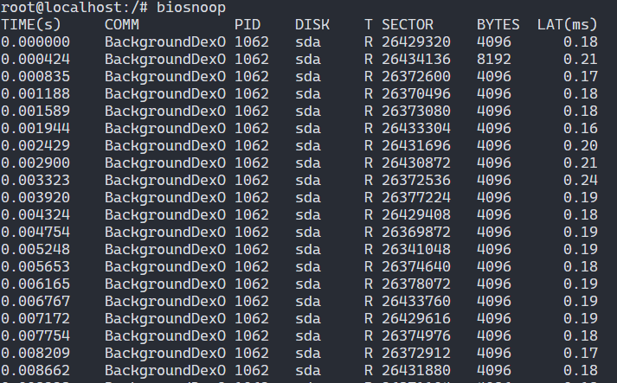
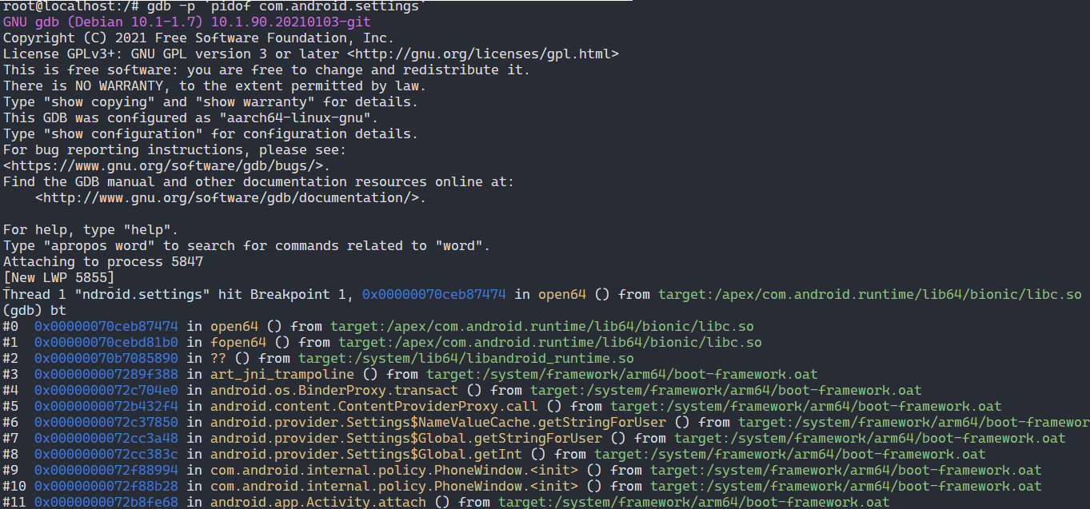

Slide 9
首届中国eBPF研讨会
02
eBPF Introduction

Slide 10
02
eBPF Introduction
首届中国eBPF研讨会
eBPF 「extended Berkeley Packet Filter」
BPF 全称「Berkeley Packet Filter」，字面意思「伯克利包过滤器」。早期主要用于实现Unix内核网络数据包过滤，发展到现在升级为 eBPF，已经演进成为了一套通用执行引擎，提供可基于系统或程序事件高效安全执行特定代码的通用能力，涵盖了性能分析、系统追踪、网络优化等方面。
原来的 BPF 就被称为cBPF（classic BPF），目前已基本废弃。
[优势]
强安全：BPF 验证器(verifier)通过沙盒机制检查每个程序，拒绝不安全的代码
高性能：JIT编译保证程序本地运行的高性能
持续交付：程序可以被无缝替换，并且不影响正在运行的任务

Slide 11
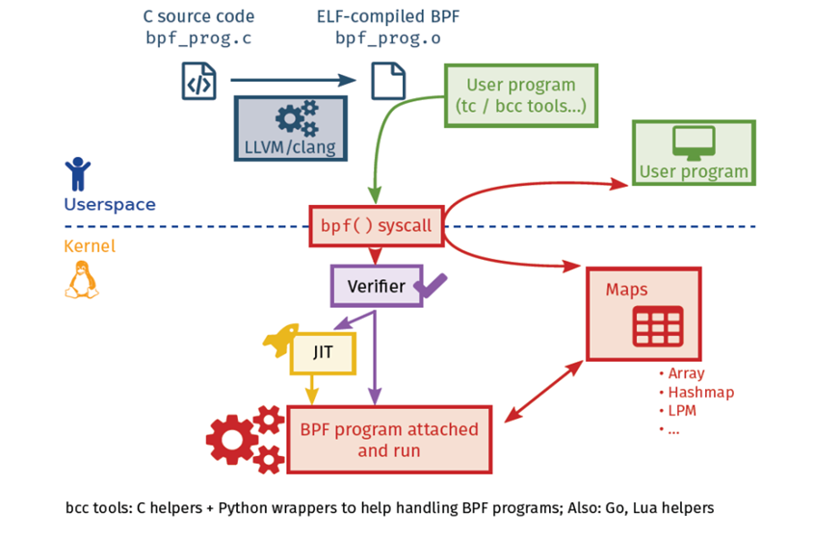
eBPF执行流程

Slide 12
cBPF vs eBPF
首届中国eBPF研讨会
struct sock_filter {
__u16 code; /* Actual filter code */
__u8 jt; /* Jump true */
__u8 jf; /* Jump false */
__u32 k; /* Generic multiuse field */
};
code是真实的bpf汇编指令，jt是指令结果为true的跳转，jf是为false的跳转，k是指令的参数，依据指令不同而不同。
一个bpf程序编译后就是一个sock_filter的数组。
struct bpf_insn {
__u8 code; /* opcode */
__u8 dst_reg:4; /* dest register */
__u8 src_reg:4; /* source register */
__s16 off; /* signed offset */
__s32 imm; /* signed immediate constant */
};
* R0 - return value from in-kernel function, and exit value for eBPF prog.
* R1 - R5 - arguments from eBPF program to in-kernel function
* R6 - R9 - callee saved registers that in-kernel function will preserve
* R10 - read-only frame pointer to access stack
多个64位寄存器为函数调用，C语言实现提供了方便，增加了众多内核 helper 函数扩展

Slide 13
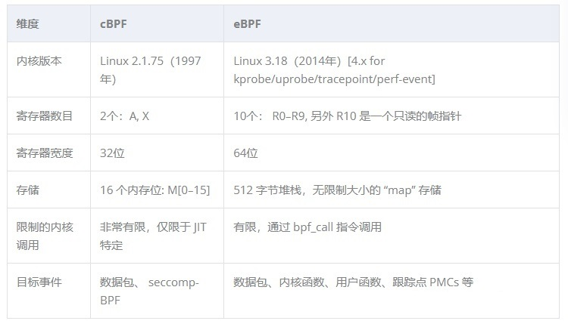

Slide 14
核心功能
首届中国eBPF研讨会
BPF Hooks
BPF钩子，也就是在内核中，哪些地方可以加载BPF程序，目前Linux内核中已经有近10余种的钩子.
如下：
kernel functions (kprobes)
userspace functions (uprobes)
system calls
fentry/fexit
tracepoints
network devices (tc/xdp)
network routes
TCP congestion algorithms
sockets (data level)
…
BPF Map
存储状态数据、与 userspace 交换信息的桥梁。
BPF Map可以被bpf程序本身及用户空间访问及操作，利用BPF Map持久化数据，在不丢失重要数据的同时，更新BPF程序逻辑，实现在不同程序之间共享信息，方便收集统计信息。

Slide 15
bpf_prog_type | 用途描述
BPF_PROG_TYPE_KPROBE | 内核动态插桩点hook
BPF_PROG_TYPE_TRACEPOINT | 内核静态跟踪点
BPF_PROG_TYPE_PERF_EVENT | 获取各种硬件、软件 perf events
BPF_PROG_TYPE_SOCKET_FILTER | 网络过滤器 ( cBPF )
BPF_PROG_TYPE_SCHED_CLS | 流量控制分类
BPF_PROG_TYPE_XDP | XDP (eXpress Data Path) - 高效底层网络hook机制
…
bpf_map_type | 用途描述
BPF_MAP_TYPE_HASH | 哈希表类型MAP
BPF_MAP_TYPE_ARRAY | 数组类型
BPF_MAP_TYPE_PERF_EVENT_ARRAY | perf event ringbuffer，与用户空间传递数据
BPF_MAP_TYPE_PERCPU_HASH | per cpu 哈希表
BPF_MAP_TYPE_PERCPU_ARRAY | per cpu 数组
BPF_MAP_TYPE_STACK_TRACE | 使用id索引的调用栈
BPF_MAP_TYPE_CGROUP_ARRAY | 针对cgroup级别的包/进程过滤

Slide 16
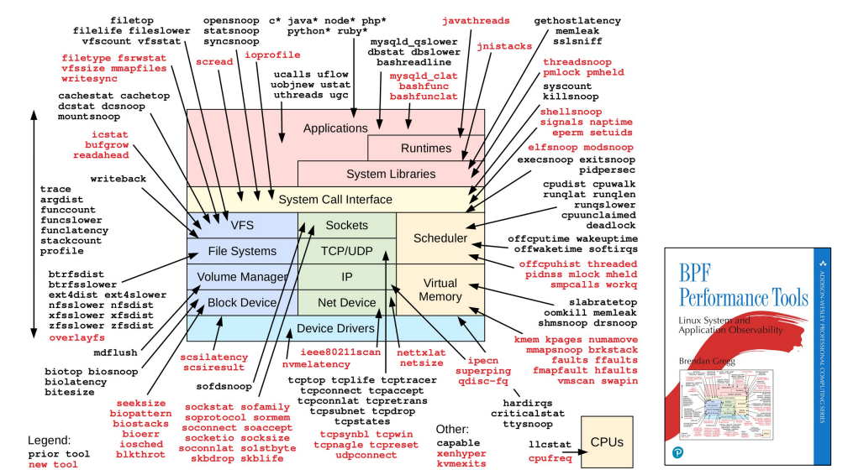
BCC tools
首届中国eBPF研讨会
BPF Compiler Collection (BCC) 是一套基于eBPF的Linux内核分析、跟踪、网络监控工具集
https://github.com/iovisor/bcc

Slide 17
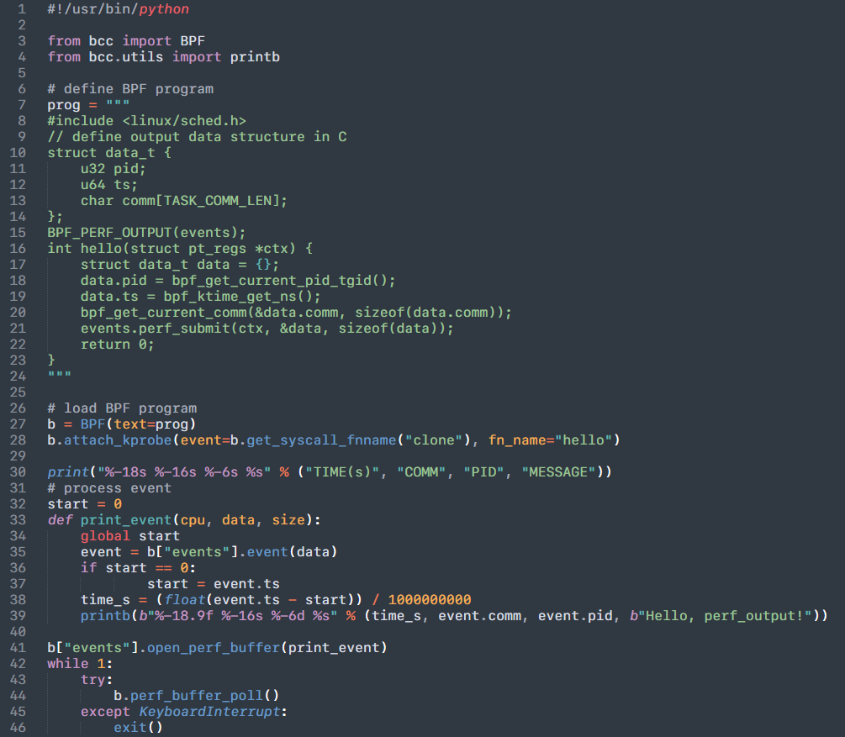
Kprobe - 内核态探针 (bcc python wrapper)
首届中国eBPF研讨会
BCC Reference Guide
[ bcc reference guide ]
[ bcc python developer tutorial ]

Slide 18
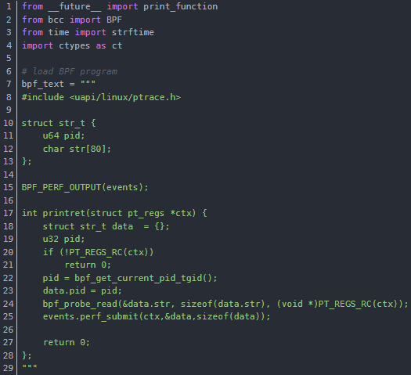
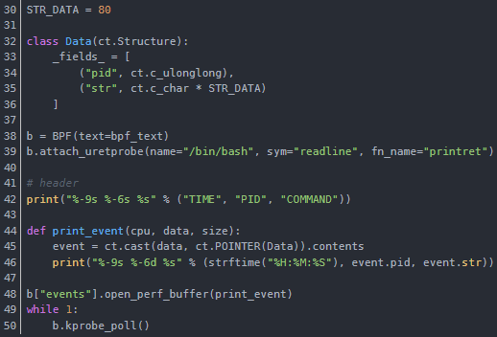
uprobe 用户态探针
首届中国eBPF研讨会

Slide 19
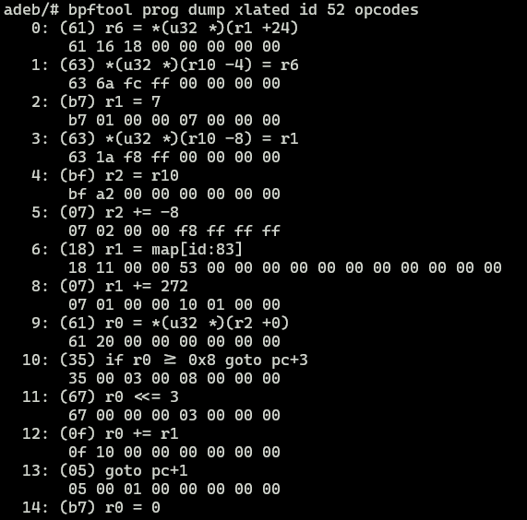
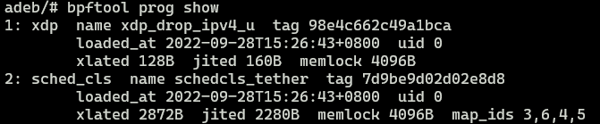
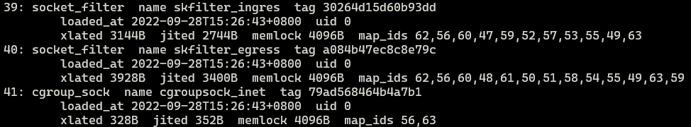
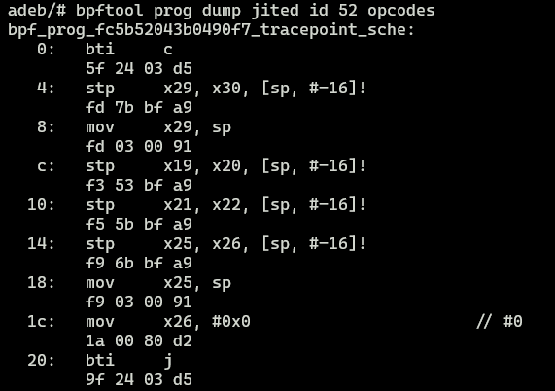
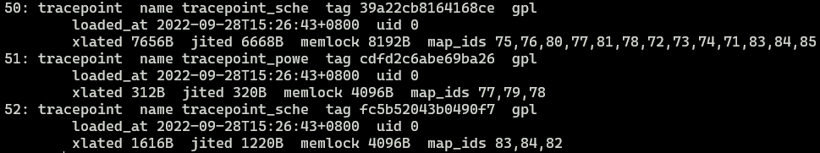
bpftool

Slide 20
bpftrace
A high-level tracing language for Linux (eBPF) available in recent Linux kernels (4.x+).
bpftrace uses LLVM as a backend to compile scripts to BPF-bytecode and makes use of BCC for interacting with the Linux BPF system.
[ awk like syntax]
probes /filter/ { actions }
# Print gpu freq changes
bpftrace -e 'tracepoint:kgsl:gpu_frequency { printf("%s %d %d\n", comm, args->gpu_freq, args->gpu_id); }'
# Show disk I/O size as a histogram
bpftrace -e 'tracepoint:block:block_rq_issue { @[comm] = sum(args->bytes); }'
# Read size distribution by process:
bpftrace -e 'kretprobe:vfs_read { @bytes = lhist(retval, 0, 2000, 200); }'
# Count page faults by process
bpftrace -e 'software:faults:1 { @[comm] = count(); }'
# Count cache misses by process name and PID (uses PMCs):
bpftrace -e 'hardware:cache-misses:1000000 { @[comm, pid] = count(); }’
# See who create threads in launcher process
bpftrace -e 'tracepoint:task:task_newtask /pid == $1/ { printf("%d %s %s\n", tid, comm, ustack()); }' `pidof com.android.launcher`
https://github.com/iovisor/bpftrace
https://github.com/iovisor/bpftrace/blob/master/docs/reference_guide.md

Slide 21
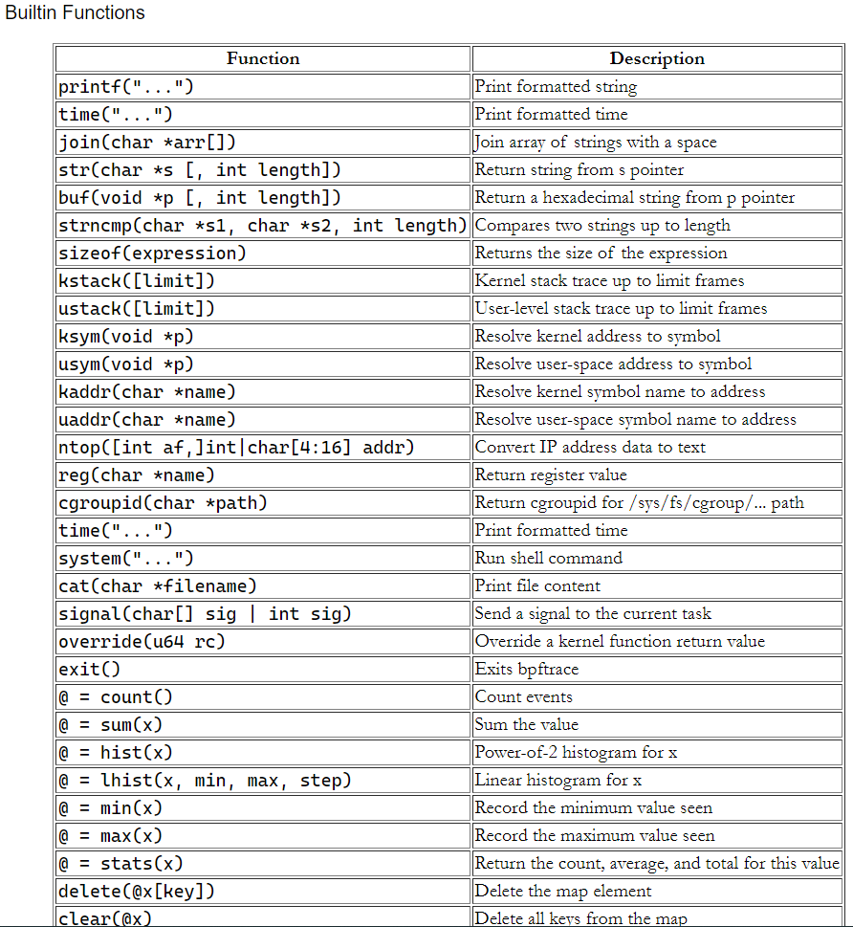
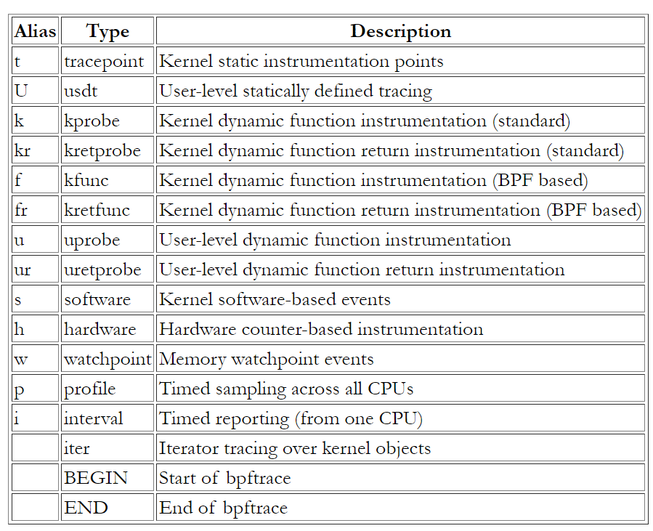
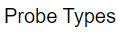
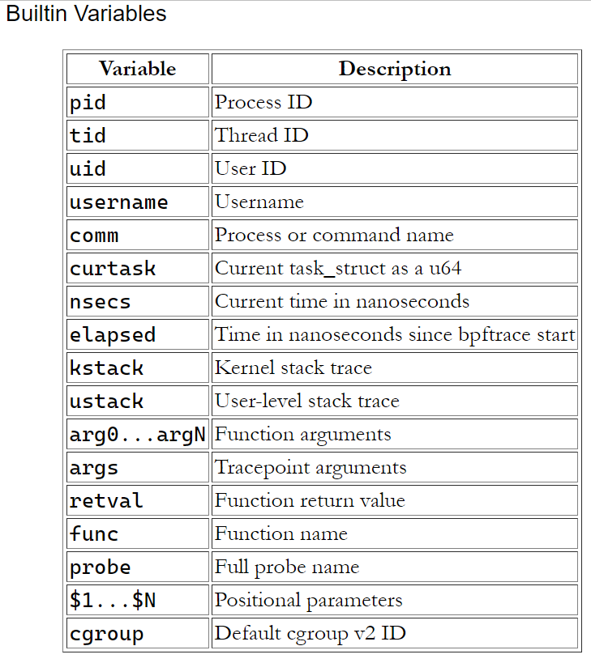
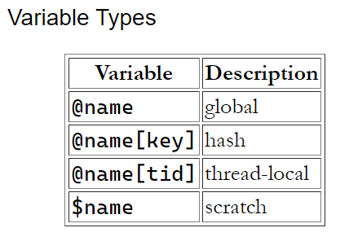
bpftrace Cheat Sheet

Slide 22
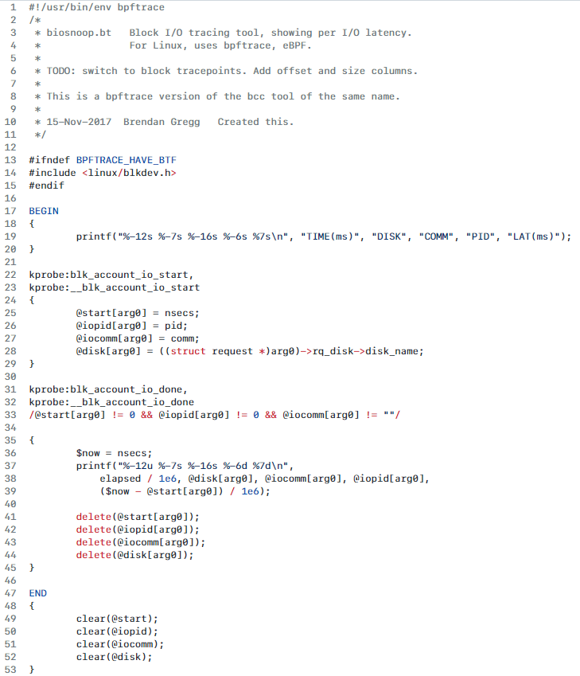
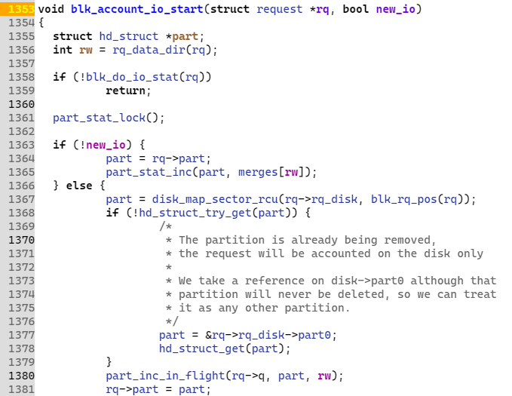
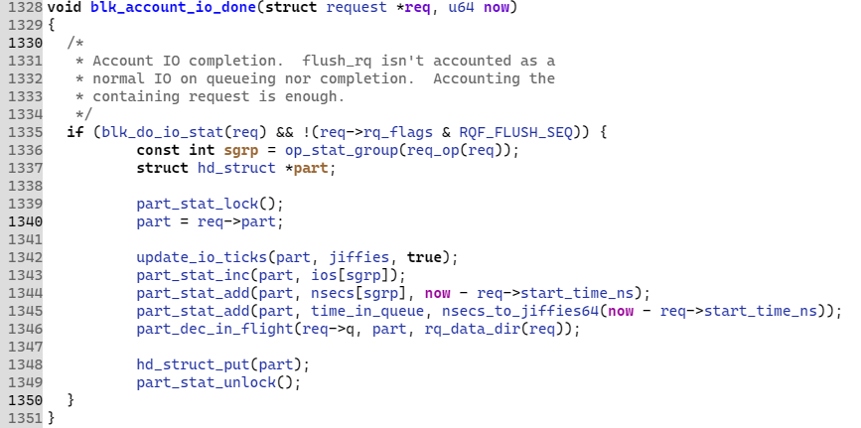

Slide 23
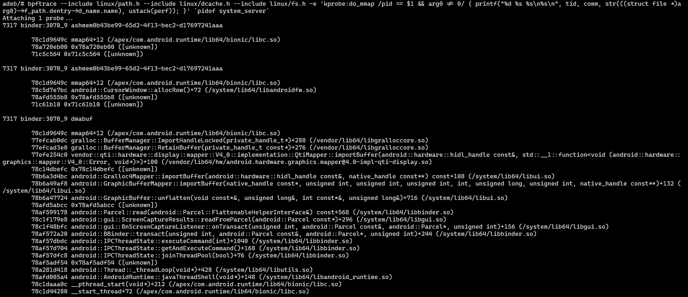
bpftrace one-line command

Slide 24
首届中国eBPF研讨会
Android eBPF
Implementation
03

Slide 25
03
首届中国eBPF研讨会
Android eBPF Implementation
Android从9.0(P)版本开始支持eBPF，其主要用于framework中的流量统计、网络过滤，CPU/IO/内存等模块的状态监控。
缺点：系统自带的bpf程序在HOST端交叉编译，devices端无llvm及kernel headers支持，kprobe支持很受限。
bpfloader
system/bpf/bpfloader，system/bpf/libbpf_android
系统启动时负责加载 /system/etc/bpf 中的bpf目标文件，create and pin maps and progs
libbpf_bcc
external/bcc
仅集成libbpf.c、perf_reader.c，为loader/framework程序提供bpf_*相关api, 封装load/pin/attach/map等bpf系统调用接口
libbpf
external/libbpf (13+)
libbpf_minimal仅为loader/client程序封装bpf相关api；提供btfloader静态链接完整功能版libbpf/libelf/libz，为支持BTF而生
Notes:
https://cs.android.com/android/platform/superproject/+/android-13.0.0_r8:system/bpf/bpfloader/Android.bp
https://cs.android.com/android/platform/superproject/+/android-13.0.0_r8:system/bpf/libbpf_android/
https://cs.android.com/android/platform/superproject/+/android-13.0.0_r8:external/bcc/Android.bp
https://cs.android.com/android/platform/superproject/+/android-13.0.0_r8:external/libbpf/Android.bp

Slide 26
[ bcc ]
cc_library {
name: "libbpf_bcc",
host_supported: false,
target: {
android: {
srcs: [
"src/cc/libbpf.c",
"src/cc/perf_reader.c",
],
},
},
shared_libs: ["libbpf_minimal"],
cflags: [
"-DHAVE_EXTERNAL_LIBBPF",
"-DMINIMAL_LIBBPF",
],
}
cc_library {
name: "libbpf_minimal",
srcs: [
"android/bpf_stub.c",
"src/bpf.c",
"src/libbpf_errno.c",
"src/netlink.c",
"src/nlattr.c",
"src/ringbuf.c",
],
}
[ libbpf ]
cc_library_static {
name: "libbpf",
host_supported: true,
srcs: [
"src/*.c",
],
static_libs: [
"libelf",
"libz",
],
}
cc_binary {
name: "btfloader",
srcs: ["android/btfloader.cpp"],
static_libs: [
"libbpf",
"libelf",
"libz"
],
}

Slide 27
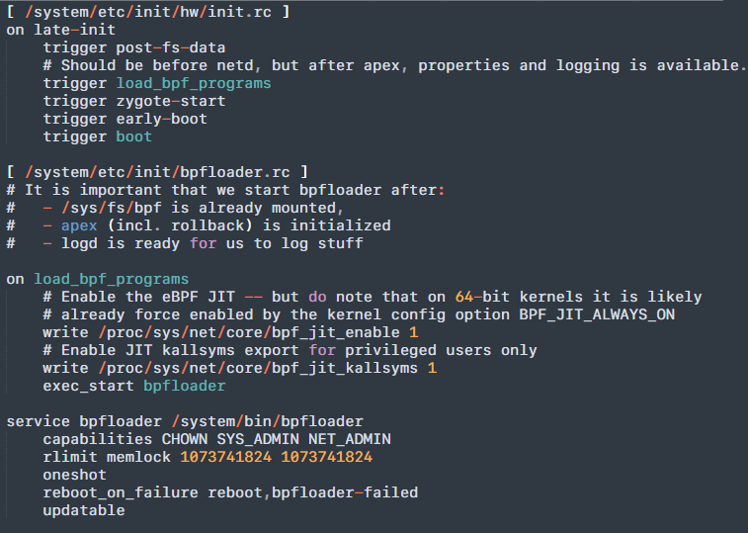
bpfloader 加载流程
首届中国eBPF研讨会
loadAllElfObjects /system/etc/bpf/*.o
loadProg /system/etc/bpf/*.o
readSection: critical、license、
readSection & check {
bpfloader_*_versize_of_bpf_[map|prog]_def
}
# read all code data in "progs" section
readCodeSections
createMaps
foreach "maps" section
getMapBtfInfo (btfloader)
bpf_create_map
pin map to {
/sys/fs/bpf/<prefix>map_<filename>_<mapname>
}
applyMapRelo
loadCodeSections
foreach codeSections
bpf_prog_load
pin prog to {
/sys/fs/bpf/<prefix>prog_<filename>_<mapname>
}
SetProperty bpf.progs_loaded = 1
[ bpfloader ]
Notes:
https://cs.android.com/android/platform/superproject/+/android-13.0.0_r8:system/bpf/libbpf_android/Loader.cpp;bpv=0;bpt=0

Slide 28
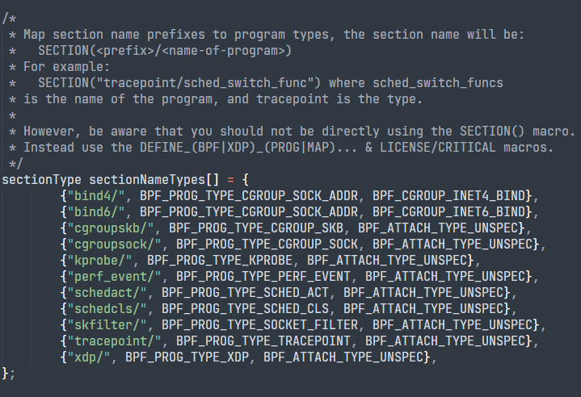
bpfloader当前支持的prog type

Slide 29
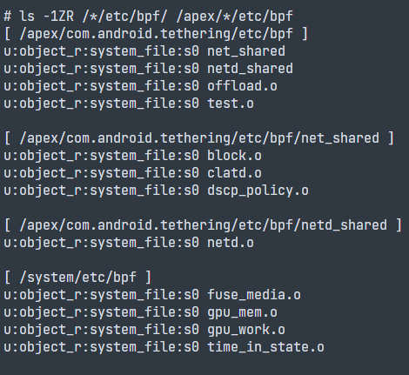
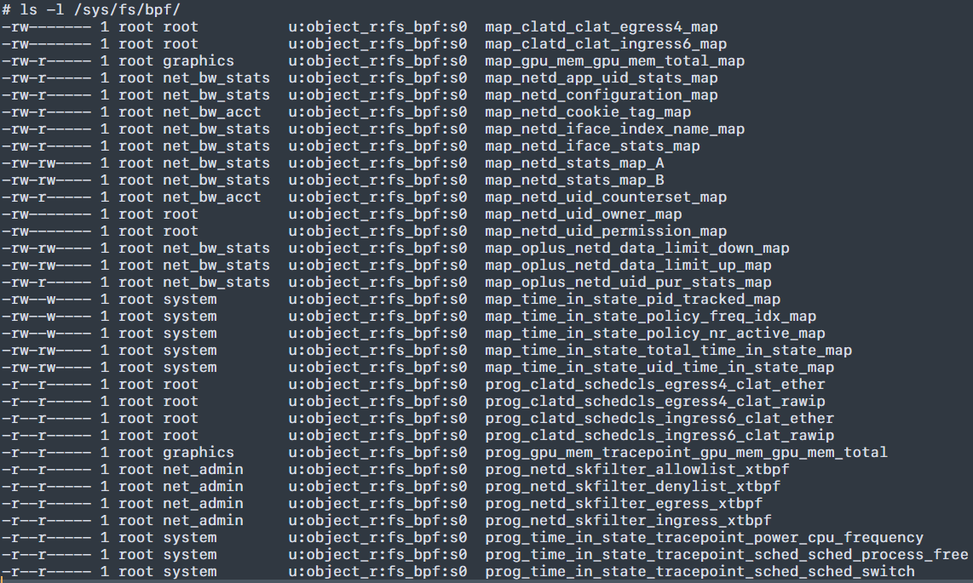
pinned bpf progs and maps

Slide 30
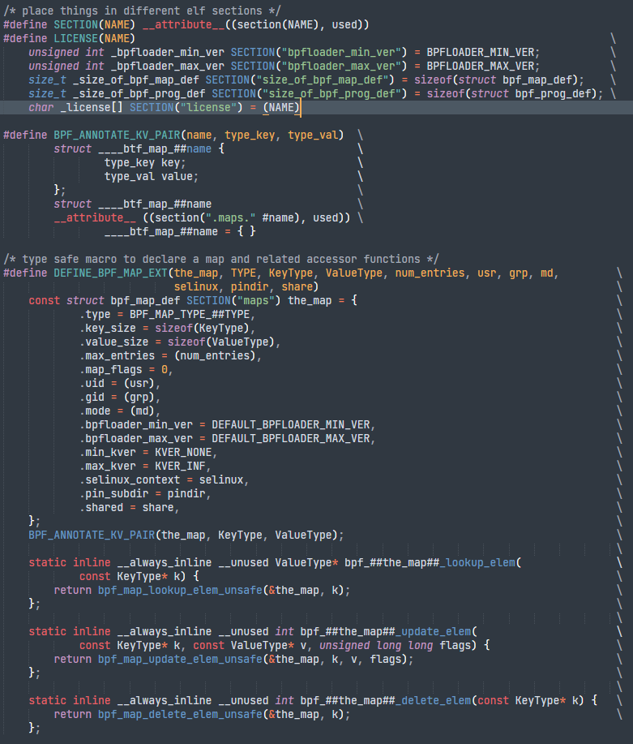
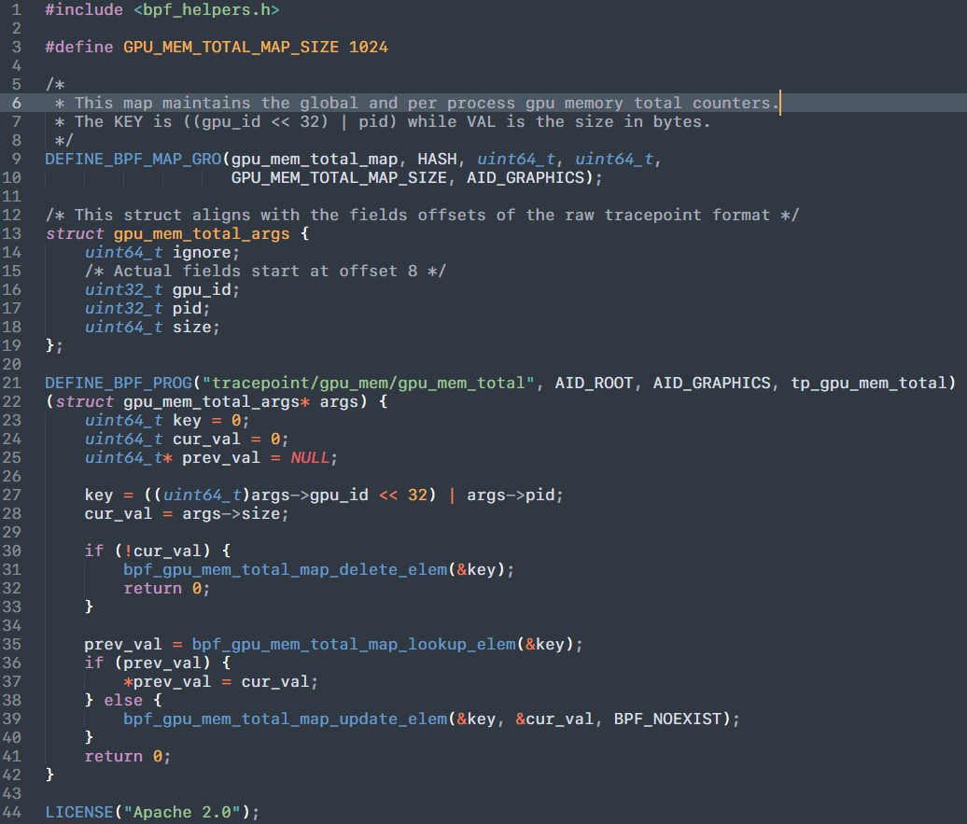
Android bpf程序格式
Android中, 一个eBPF的c程序格式如上：
1. 通过 DEFINE_BPF_MAP 定义BPF数据容器的类型以及访问接口
2. 通过 DEFINE_BPF_PROG 声明并定义hook方法
3. LICENSE指定程序使用的license

Slide 31
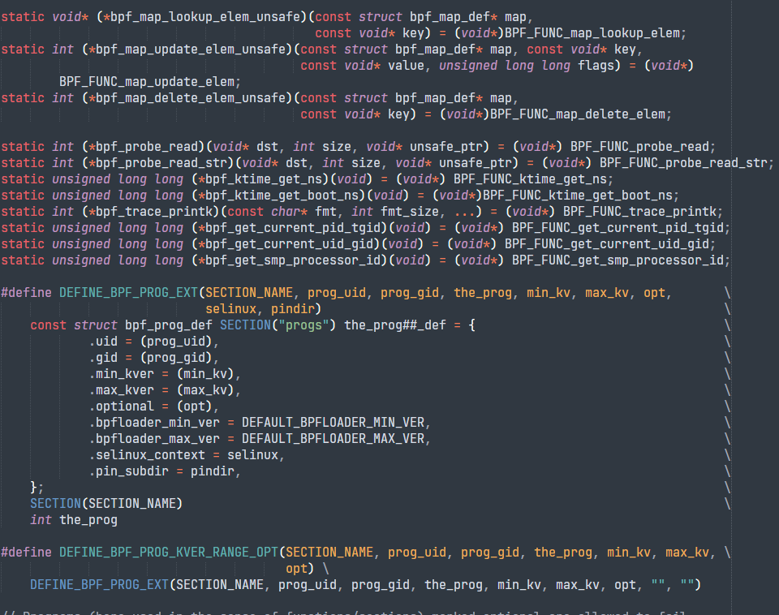
Notes:
https://cs.android.com/android/platform/superproject/+/master:frameworks/native/services/gpuservice/bpfprogs/gpuMem.c

Slide 32
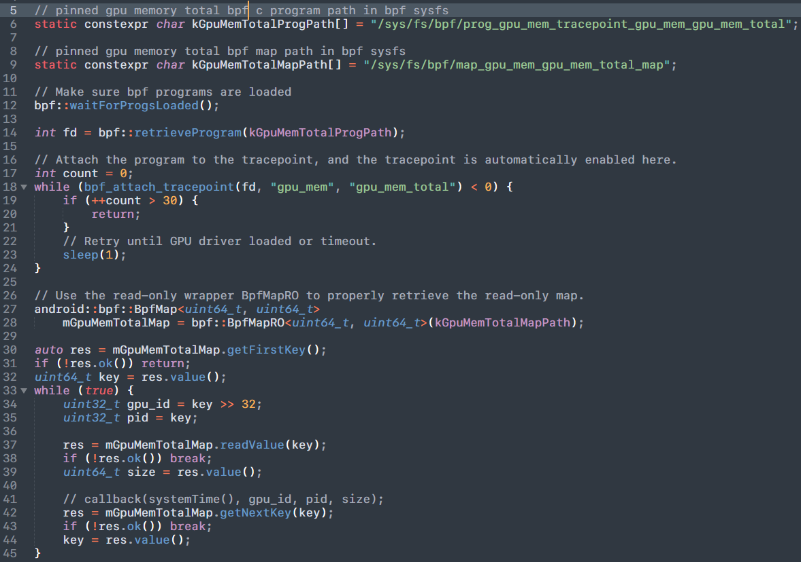
[usage]

Slide 33
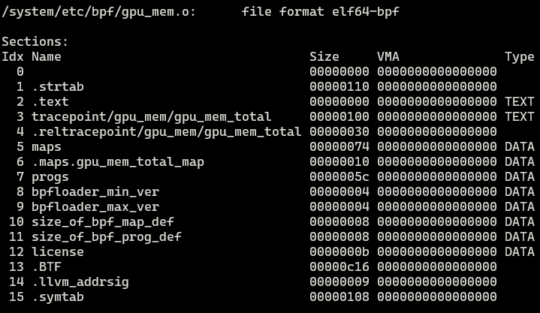
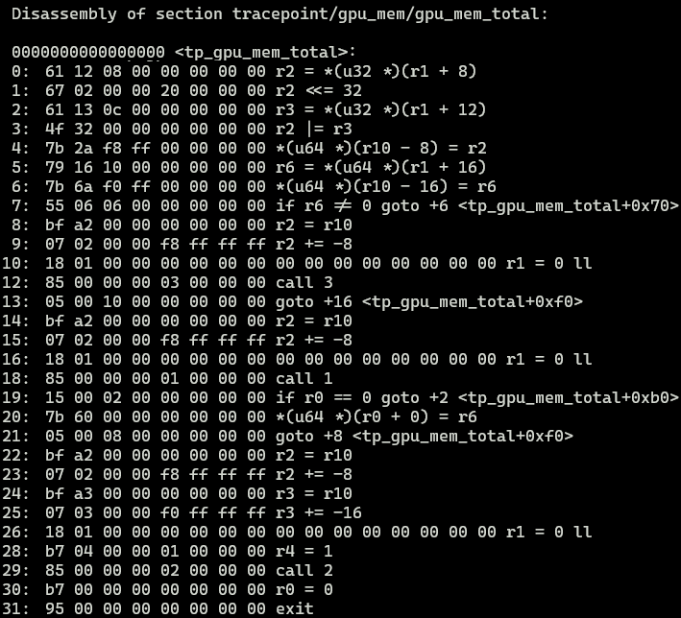
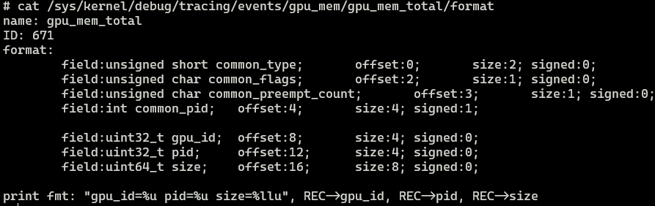
adeb shell llvm-objdump-11 -h -d /system/etc/bpf/gpu_mem.o

Slide 34
首届中国eBPF研讨会
04
BTF (BPF Type Format)

Slide 35
04
BTF (BPF Type Format)
首届中国eBPF研讨会
BCC缺点：
1. 编译时依赖 kernel headers，需要 llvm/clang 工具；
2. kernel struct 定义变更引起 memory layout变化，导致编译生成的bpf程序无法兼容不同 kernel，不利于bpf二进制程序分发
BTF 引入了灵活的动态解析机制，对struct成员进行动态定位，基于kernel提供的BTF机制，结合 libbpf 与 bpftool，可将 bpf 程序与用户态程序编译封装至单个 ELF 文件，实现 CO-RE (Compile Once, Run Everywhere)。

Slide 36
BTF support in Android T
( Android emulator with kernel 5.15 )
首届中国eBPF研讨会
emu64xa:/ $ zcat /proc/config.gz | grep -E "BTF|BPF"
CONFIG_BPF=y
CONFIG_HAVE_EBPF_JIT=y
CONFIG_ARCH_WANT_DEFAULT_BPF_JIT=y
CONFIG_BPF_SYSCALL=y
CONFIG_BPF_JIT=y
CONFIG_BPF_JIT_ALWAYS_ON=y
CONFIG_BPF_JIT_DEFAULT_ON=y
CONFIG_CGROUP_BPF=y
CONFIG_NETFILTER_XT_MATCH_BPF=y
CONFIG_NET_CLS_BPF=y
CONFIG_NET_ACT_BPF=y
CONFIG_BPF_LIRC_MODE2=y
CONFIG_DEBUG_INFO_BTF=y
CONFIG_PAHOLE_HAS_SPLIT_BTF=y
CONFIG_DEBUG_INFO_BTF_MODULES=y
CONFIG_MODULE_ALLOW_BTF_MISMATCH=y
CONFIG_BPF_EVENTS=y
emu64xa:/ # ls -1 /sys/kernel/btf/*
/sys/kernel/btf/usbip_core
/sys/kernel/btf/vkms
/sys/kernel/btf/vmlinux
/sys/kernel/btf/zram
/sys/kernel/btf/zsmalloc
...

Slide 37
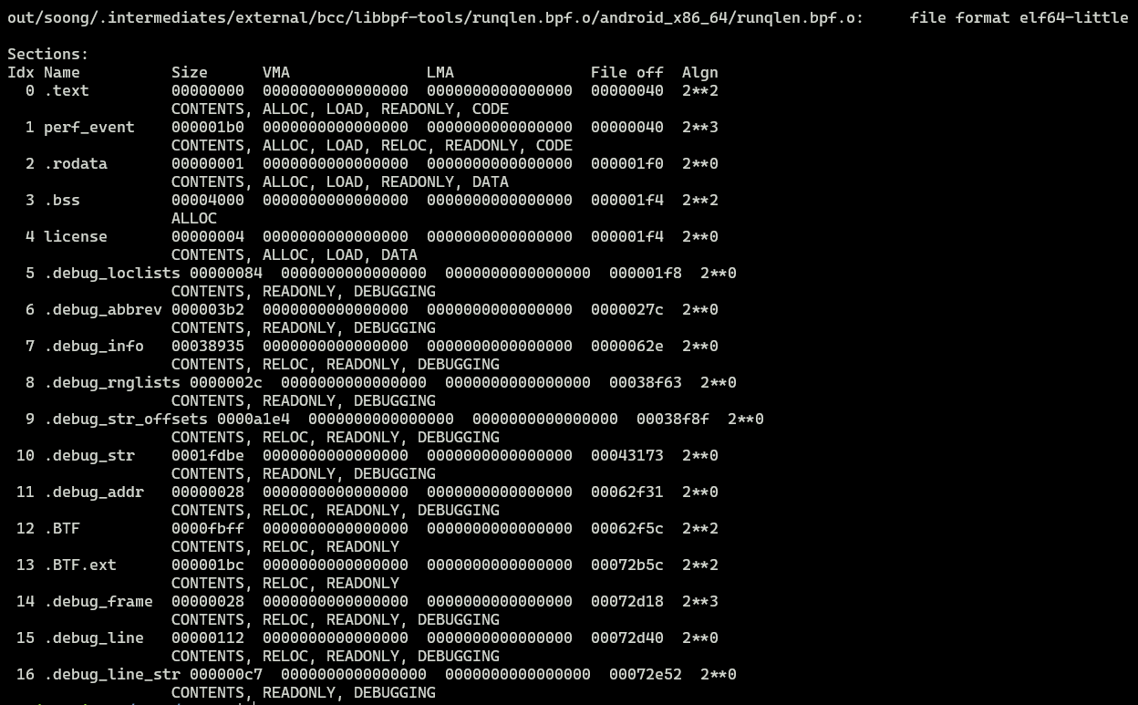
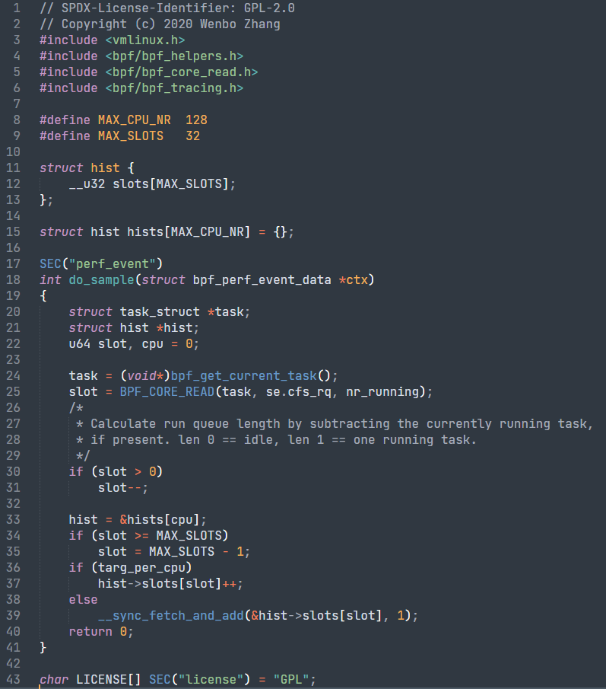
bpf program with BTF support
首届中国eBPF研讨会
objdump -h runqlen.o
runqlen.bpf.c

Slide 38
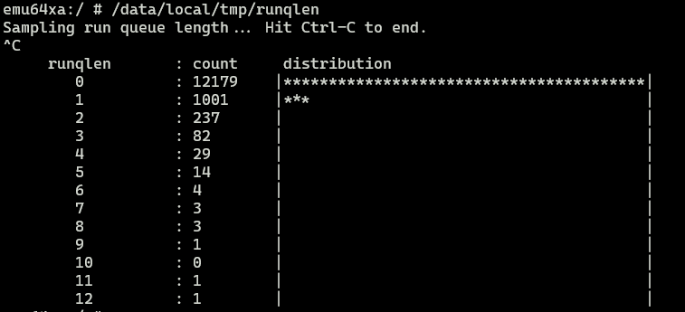
runqlen.c [ client program with btf support ]
runqlen_bpf__open // runqlen.skel.h
runqlen_bpf__load // runqlen.skel.h
open_and_attach_perf_event
+ perf_event_open
+ bpf_program__attach_perf_event // libbpf
print_linear_hists
runqlen_bpf__destroy // runqlen.skel.h

Slide 39


BTFGen - No kernel BTF support
( kernel version < 5.15 )
首届中国eBPF研讨会
change [sys/external/bcc/libbpf-tools/runqlen.c]
- obj = runqlen_bpf__open();
+ LIBBPF_OPTS(bpf_object_open_opts, opts, .btf_custom_path = "./vmlinux.btf");
+ obj = runqlen_bpf__open_opts(&opts);
$ mmma external/bcc/libbpf-tools
$ pahole --btf_encode_detached kernel.btf vnd/kernel_platform/out/dist/vmlinux
$ find sys/out/soong/.intermediates/external/bcc/libbpf-tools -type f -name "*.bpf.o" \
| xargs bpftool gen min_core_btf ./kernel.btf ./vmlinux.btf
push sys/out/**/system/bin/runqlen and vmlinux.btf to device (/data/local/tmp/)
Notes:
Build latest pahole: git clone https://github.com/acmel/dwarves.git; mkdir dwarves/build; cd dwarves/build; cmake -D__LIB=lib .. ; make install
Build bpftool: git clone --recurse-submodules https://github.com/libbpf/bpftool.git; cd bpftool/src; make && make install
$ cd bcc/libbpf-tools ## customizing btf path for all tools
$ for f in *.c; do sed -ri 's:(\w+) = (\w+)_bpf__open\(\);:LIBBPF_OPTS(bpf_object_open_opts, opts, .btf_custom_path = "./vmlinux.btf");\n\t\1 = \2_bpf__open_opts(\&opts);:g' $f; done

Slide 40
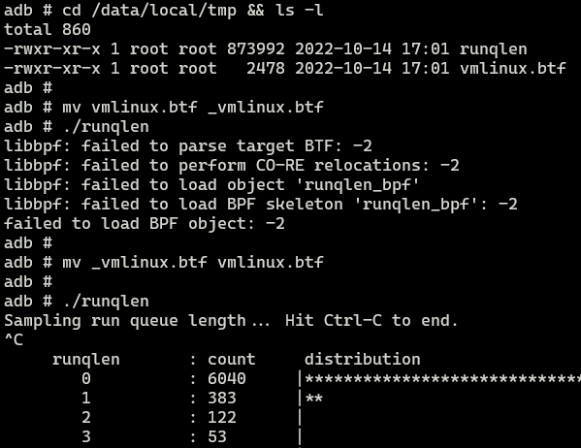

Slide 41
首届中国eBPF研讨会
05
eBPF changes for Android

Slide 42
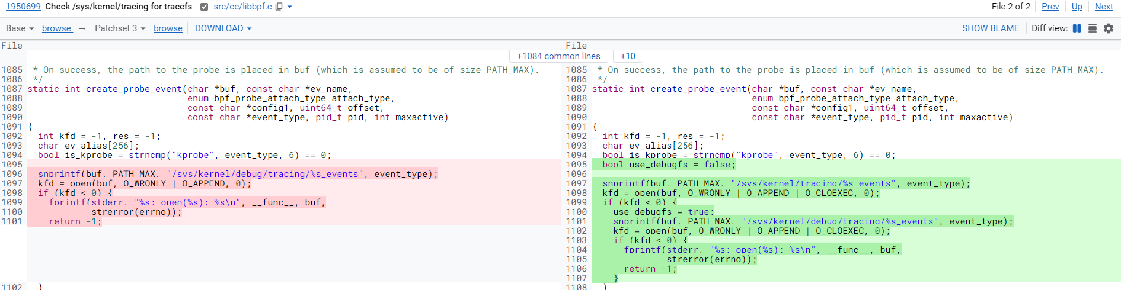
05
eBPF changes for Android
bcc changes [ debugfs deprecation]
自Android 11开始 移除debugfs 支持
CONFIG_DEBUG_FS isn't enabled in the device’s kernel config
debugfs isn't listed under /proc/filesystems.
为了避免影响基于ftrace的systrace/perfetto等工具，Android上层对所有 tracefs 挂载点重新做了相关适配
/sys/kernel/debug/tracing => /sys/kernel/tracing

Slide 43
selinux policies
首届中国eBPF研讨会
typeattribute bpfloader bpfdomain; # also: netd, network_stack, system_server
allow bpfdomain fs_bpf:dir search;
# allow bpfloader to create bpf maps and programs.
allow bpfloader self:bpf { map_create map_read map_write prog_load prog_run };
allow network_stack bpfloader:bpf { map_read map_write prog_run };
# give netd permission to setup iptables rule with xt_bpf
# attach program to cgroup, and read/write the map created by bpfloader
allow netd bpfloader:bpf { prog_run map_read map_write };
# allow system_server to read/update eBPF maps that stores the traffic stats info.
allow system_server bpfloader:bpf { map_read map_write prog_run };
[ init ]
allow init fs_bpf:dir mounton;
domain_auto_trans(init, bpfloader_exec, bpfloader)
neverallow { domain -bpfdomain } *:bpf *;
class bpf
{
map_create
map_read
map_write
prog_load
prog_run
}

Slide 44
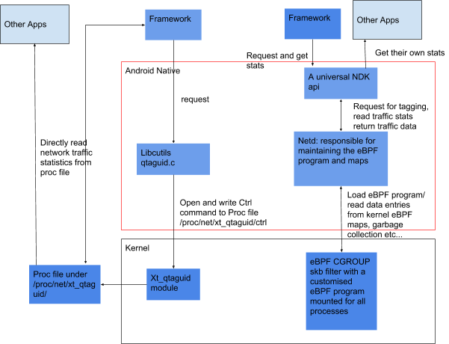
eBPF Traffic Monitoring
[ From Android 9+ ]
The new eBPF tool is replacing the xt_qtaguid module and the xt_owner module it is based on.
Legacy (left) and eBPF (right) traffic monitoring design differences
https://source.android.com/docs/core/data/ebpf-traffic-monitor

Slide 45
socket tagging
[ before 9.x ]
static int write_ctrl(const char *cmd)
{
fd = open("/proc/net/xt_qtaguid/ctrl", ..);
res = write(fd, cmd, strlen(cmd));
}
int qtaguid_tagSocket(int sockfd, int tag, uid_t uid) {
char lineBuf[128];
uint64_t kTag = ((uint64_t)tag << 32);
snprintf(lineBuf, sizeof(lineBuf),
"t %d %" PRIu64 " %d", sockfd, kTag, uid);
write_ctrl(lineBuf);
}
[ 9.x + ]
BpfMap<uint64_t, UidTagValue> mCookieTagMap;
mCookieTagMap.init(
"/sys/fs/bpf/netd_shared/map_netd_cookie_tag_map")
int BpfHandler::tagSocket(int sockFd,
uint32_t tag, uid_t chargeUid, uid_t realUid)
{
mCookieTagMap.writeValue(sock_cookie, newKey, BPF_ANY);
}
int qtaguid_tagSocket(int sockfd, int tag, uid_t uid)
{
return netdHandler.netdTagSocket(sockfd, tag, uid);
}

Slide 46
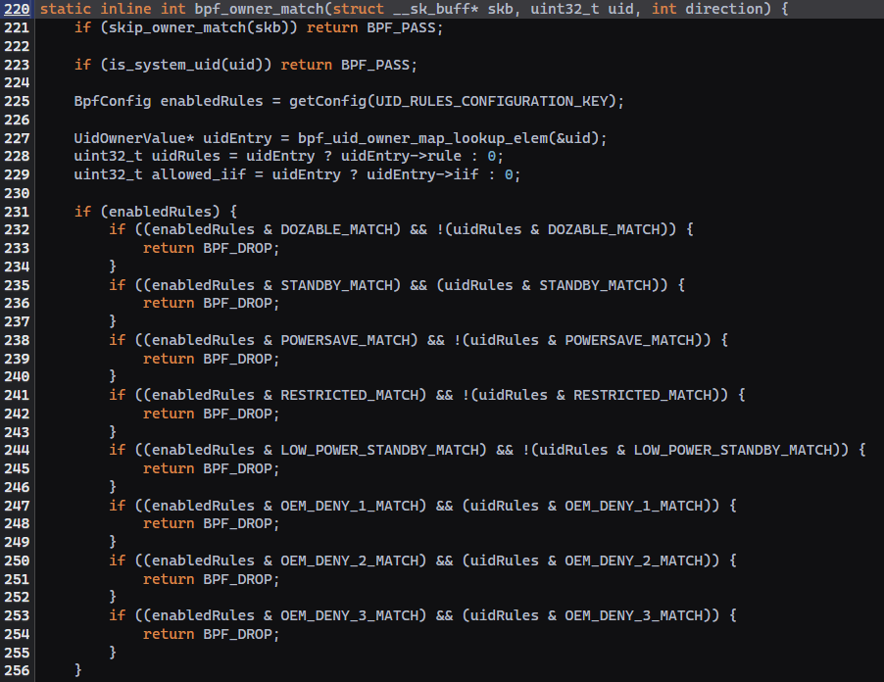
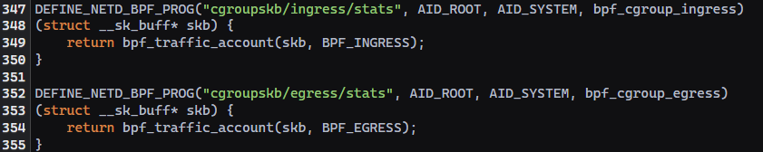
traffic control
CODE REFERENCE

Slide 47
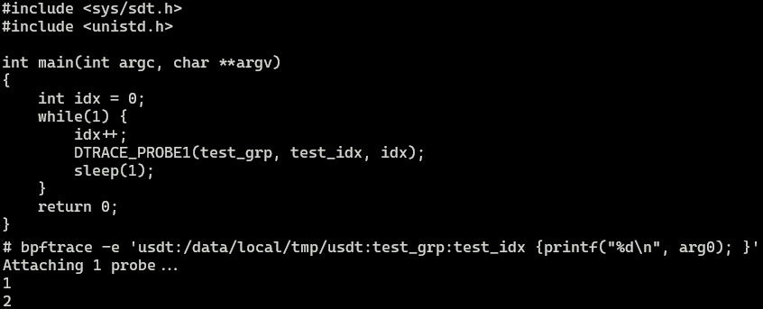
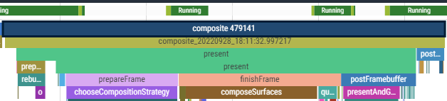
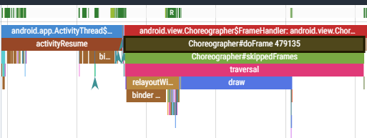
usdt | systrace/perfetto
[ usdt ]
clang兼容性不好, 不支持JAVA, Android平台受限较大
[ Perfetto ]
可使用Trace/ATRACE相关接口定义,借助 ui 直观呈现,数据分析功能强大
 Android平台推荐使用systrace API 输出跟踪数据, 使用用 perfetto 获取并分析trace数据
Perfetto分析进阶 (内核工匠): https://mp.weixin.qq.com/s/gXNm24I1qFw-xRhQC-Zsow

Slide 48
syscall args in arm64
 int kill(pid_t pid, int sig)
# bpftrace -e 'kprobe:__arm64_sys_kill { printf("%d %s %d %d\n", pid, comm, arg0, arg1); }'
Attaching 1 probe...
31251 sh 829931184 829931184 ??
…
# bpftrace -e 'kprobe:__arm64_sys_kill { printf("%d %s %d %d\n", pid, comm, *(uint64*)arg0, *((uint64*)arg0+1)); }'
Attaching 1 probe...
31251 sh 22895 3
…

Slide 49
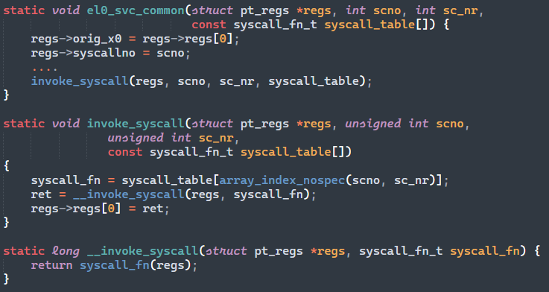
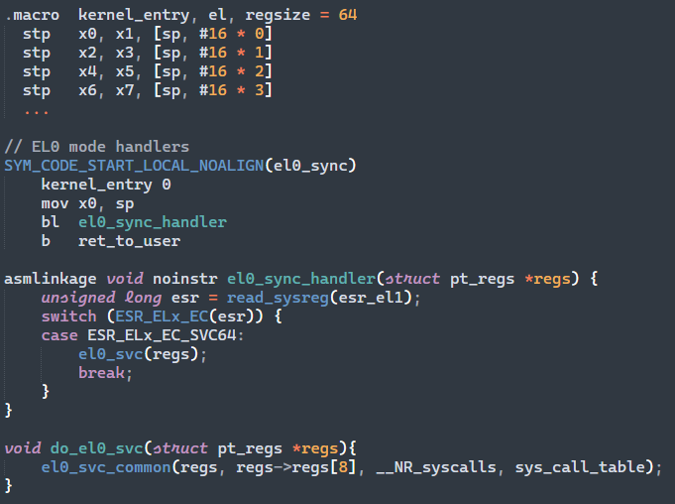
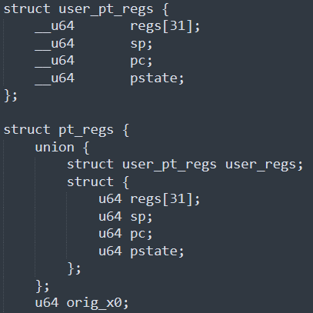
syscall flow
__arm64_sys_kill

Slide 50
ustack issue (adeb环境)
1. bpftrace -e 'kprobe:__arm64_sys_openat /pid == $1/ { printf("%s %s\n", comm, ustack(perf)) }' `pidof system_server`
getTemperature
76254d925c __openat+12 (/apex/com.android.runtime/lib64/bionic/libc.so)
74e04db01c 0x74e04db01c ([unknown])
74e04dae08 0x74e04dae08 ([unknown])
7502513744 0x7502513744 ([unknown])
…
2. bpftrace -e 'u:/system/framework/arm64/boot-framework.oat:android.app.Activity.onCreate { printf("%s\n%s\n", comm, ustack(perf)); }'
No probes to attach

Slide 51
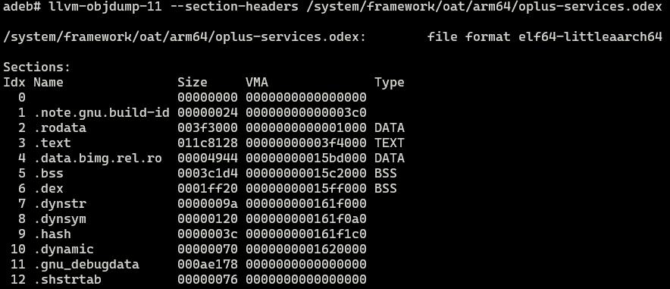

# file /apex/com.android.runtime/lib64/bionic/libc.so ( not stripped 意味着还可以使用uprobe )
/apex/com.android.runtime/lib64/bionic/libc.so: ELF 64-bit LSB shared object, ARM aarch64, version 1
(SYSV), dynamically linked, BuildID[md5/uuid]=59222d1015276d9a9031ee1ea28c0bcd, not stripped
# file /system/framework/oat/arm64/oplus-services.odex
/system/framework/oat/arm64/oplus-services.odex: ELF 64-bit LSB shared object, ARM aarch64, version 1 (GNU/Linux), dynamically linked, BuildID[sha1]=8564bd48a484a18502f34962b3f09573e6fee5ad, stripped
Notes:
https://sourceware.org/gdb/onlinedocs/gdb/MiniDebugInfo.html

Slide 52
Android .odex
.note.gpu.build-id
.rodata
.text
.bss
.dex
.dynstr
.dynsym
.hash
.dynamic
.gnu_debugdata
.shstrstab
尝试修改bcc, 将.gnu_debugdata section
xz解压到符号目录以便于bcc解析符号
/usr/lib/debug/.build-id/
{buildid[0]}{buildid[1]}/{buildid + 2}.debug
unxz

Slide 53



后续用户态调用栈解析也可考虑使用Android自带的libunwindstack ( 支持elf/dex/oat/jit/... ) , 需要(stack+regs)支持; 且需考虑权限问题, 比如并非所有 bpfdomain 进程都有权限遍历所有进程maps中elf文件

Slide 54


当前eBPF kernel实现中获取 ustack 仅通过frame-pointer展开各级栈帧，而 Android 生成的 oat/odex 默认均 omit-frame-pointer，导致 callstack 从源头上无法正确获取 …
硬伤，最好是 kernel 支持 arm64 LBR 方式获取callstack ？
Notes:
https://github.com/iovisor/bcc/issues/1234
https://github.com/iovisor/bpftrace/issues/1006

Slide 55
首届中国eBPF研讨会
06
Analyzing issues with eBPF

Slide 56

06
Analyzing issues with eBPF
UI主线程大量D状态，block在 proc_cgroup_show

Slide 57
/* cgroup_mutext.bt */
BEGIN {
@cgm = kaddr("cgroup_mutex");
}
kprobe:__mutex_lock_slowpath
/arg0 == @cgm/
{
@lock_start[tid] = nsecs;
}
kprobe:__mutex_unlock_slowpath
/arg0 == @cgm && @lock_start[tid]/
{
printf("%d\t%s\t%ld\t%s\t%s\n", pid, comm,
nsecs - @lock_start[tid], kstack(4), ustack(8));
delete(@lock_start[tid]);
}
END {
clear(@lock_start);
clear(@cgm);
}
目标进程出现大量此类调用栈
7643 com.xxx.yyy 5260
__mutex_unlock_slowpath+0
proc_cgroup_show+1140
proc_single_show+112
seq_read+468
read+12
android::base::ReadFileToString
CgroupController::GetTaskGroup
get_sched_policy+136
android_os_Process_getProcessGroup+60
android.os.Xxxx.getSchedGroup
...
[ 解决办法 ]
private boolean isForegroundApp(int pid) {
- return (getSchedGroup(pid) == PROCESS_STATUES_TOP) && … )
+ return (mForegroundFlag == PROCESS_STATUES_TOP) && …
}

Slide 58


global property change watching
bpftrace -e 'u:/apex/com.android.runtime/lib64/bionic/libc.so:__system_property_set \
{ printf("[%s] setprop (%s) => (%s)\n", comm, str(arg0), str(arg1)); }'

Slide 59

总 结
adeb (android debian)
eBPF Introduction
Android eBPF Implementation
BTF (BPF Type Format)
eBPF changes for Android
Analyzing issues with eBPF

Slide 60
Thanks

